Slide 1
PROJECT TITLE
CAPSTONE PROJECT
Presented By:
1. Asha Rayadurai-Tagore Institute of Engineering and Technology-B.Tech-AI&DS

Slide 2
OUTLINE
Problem Statement (Should not include solution)
Proposed System/Solution
System Development Approach (Technology Used)
Algorithm & Deployment
Result (Output Image)
Conclusion
Future Scope
References

Slide 3
Problem Statement
Access to safe and improved sources of drinking water remains a critical issue in India, especially in rural and underdeveloped regions. Despite ongoing efforts under the Sustainable Development Goals (SDGs), inequalities persist in water accessibility across states and socio-economic groups. This project aims to analyze data from the 78th Round of the Multiple Indicator Survey (MIS) to assess the percentage of the population with access to improved drinking water sources. It will also explore related indicators such as use of clean cooking fuel and migration trends. By identifying patterns and disparities, the study will generate actionable insights to support evidence-based policymaking. The ultimate goal is to help ensure equitable access to clean water and contribute to India's progress on SDG targets.

Slide 4
Proposed Solution
The proposed system aims to address the percentage of the population with access to improved drinking water sources. It will also
explore related indicators such as use of clean cooking fuel and migration trends. The solution will consist of the following components:
Data Collection:
Gather historical data on census of India,Water and Sanitation Program, Per capita water availability.
Utilize real-time data sources, such as India Water Tool,State of water Resources in India(2024),National Family Health Survey(NFHS).
Data Preprocessing:
Clean and preprocess the collected data to handle missing values, outliers, and inconsistencies.
Feature engineering to extract relevant features from the data that might impact water demand.
Machine Learning Algorithm:
Implement a machine learning algorithm, such as XGBoost and LightGBM, to predict the water
Consider incorporating other factors like Water source,Water quality,Geographic location.
Deployment:
Develop a user-friendly interface or application that provides real-time predictions for water survey for a people.
Deploy the solution on a scalable and reliable platform, considering factors like server infrastructure, response time, and user accessibility.
Evaluation:
Assess the model's performance using appropriate metrics such as Mean Absolute Error (MAE), Root Mean Squared Error (RMSE), or other relevant metrics.
Fine-tune the model based on feedback and continuous monitoring of prediction accuracy.
Result:Finally,it tells the water resources available for peoples based on percentage.

Slide 5
System Approach
The "System Approach" section outlines the overall strategy and methodology for developing and implementing the percentage of the population with access to improved drinking water sources. Here's a suggested structure for this section:
System requirements
IBM Cloud(Mandatory)
IBM Watsonx studio service for model development and deployment
IBM Cloud object storage for dataset handling

Slide 6
Algorithm & Deployment
In the Algorithm section, describe the machine learning algorithm chosen for predicting percentage of the population with access to improved drinking water sources. Here's an example structure for this section:
Algorithm Selection:
Supervised (Random Forests),Unsupervised (K-Means Clustering) and it gives accuracy with LightGBM.
Data Input:
Types of water sources(pipe,well,riveretc...),Region,State,Village,Bacterial Contamination,Age,Gender,Sector.
Training Process:
Hyperparameter Tuning optimizes model performance by finding the best combinations of hyperparameter.
Prediction Process:
Prediction process uses regression and classification to evaluate the models future use.

Slide 7
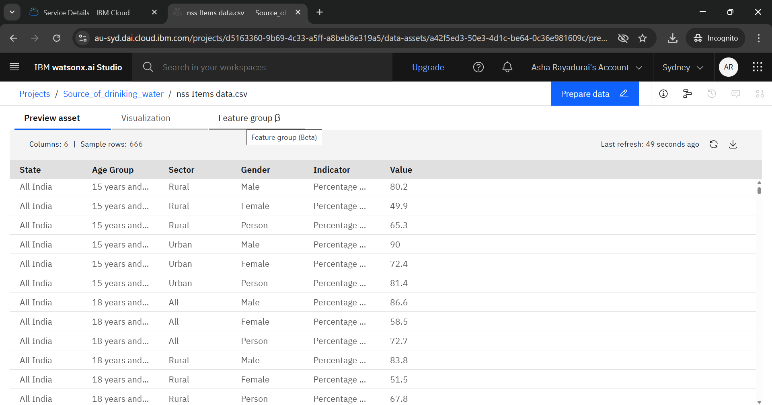
Result

Slide 8
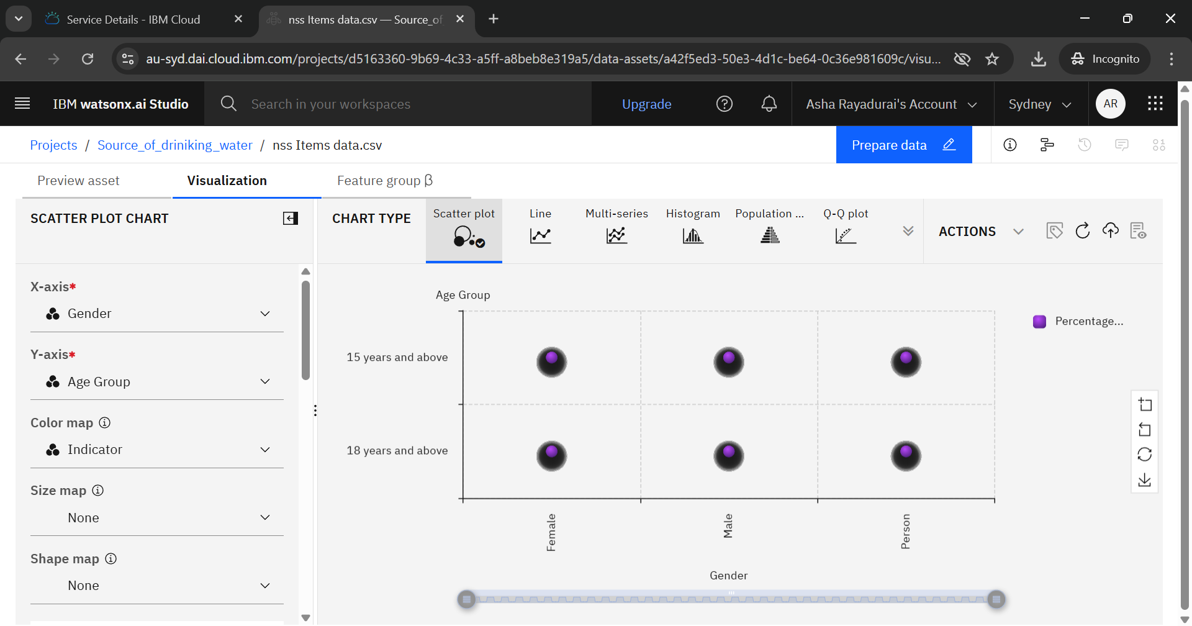
Result

Slide 9
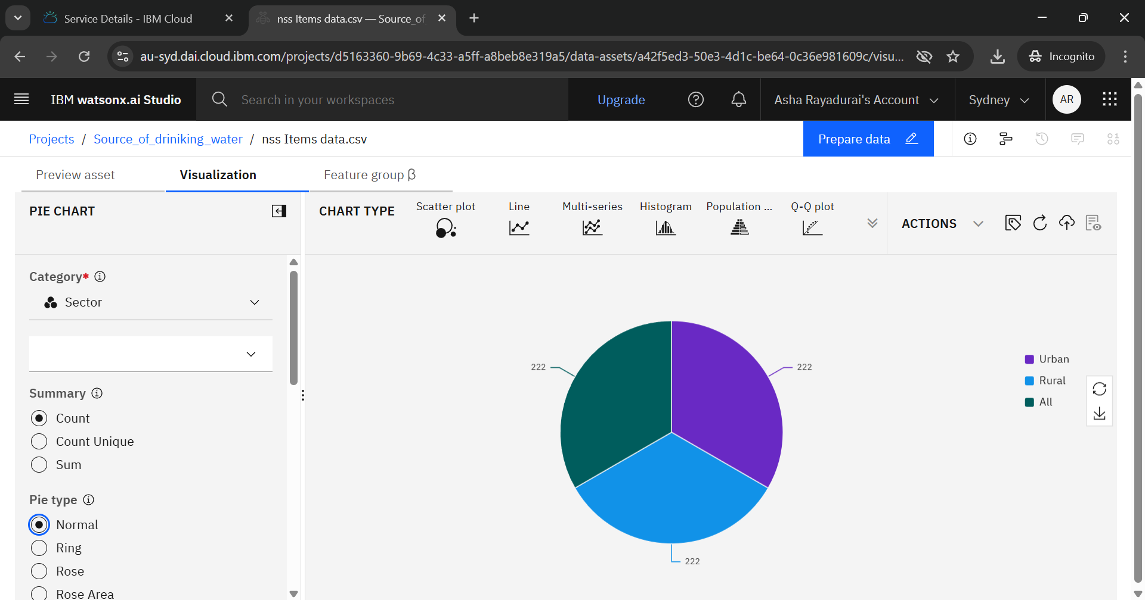
Result

Slide 10
Conclusion
The development and deployment of machine learning models can significantly enhance our understanding of access to improved drinking water sources. By leveraging socio-economic, geographic, and water quality data, these models can predict outcomes and identify areas for improvement. This can inform evidence-based policymaking, optimize resource allocation, and ultimately improve the health and well-being of communities.

Slide 11
Future scope
Future research can focus on integrating machine learning with IoT sensors and real-time data to enable proactive water management. Additionally, developing early warning systems for water-related disasters and personalized water management systems can further enhance the impact. Expanding the scope to other water-related issues, such as water scarcity and wastewater management, can also be explored.

Slide 12
References
AI Kosh Dataset Link –
https://aikosh.indiaai.gov.in/web/datasets/details/improved_source_of_drinking_water_multiple_indicator_survey_78th_round.html

Slide 13
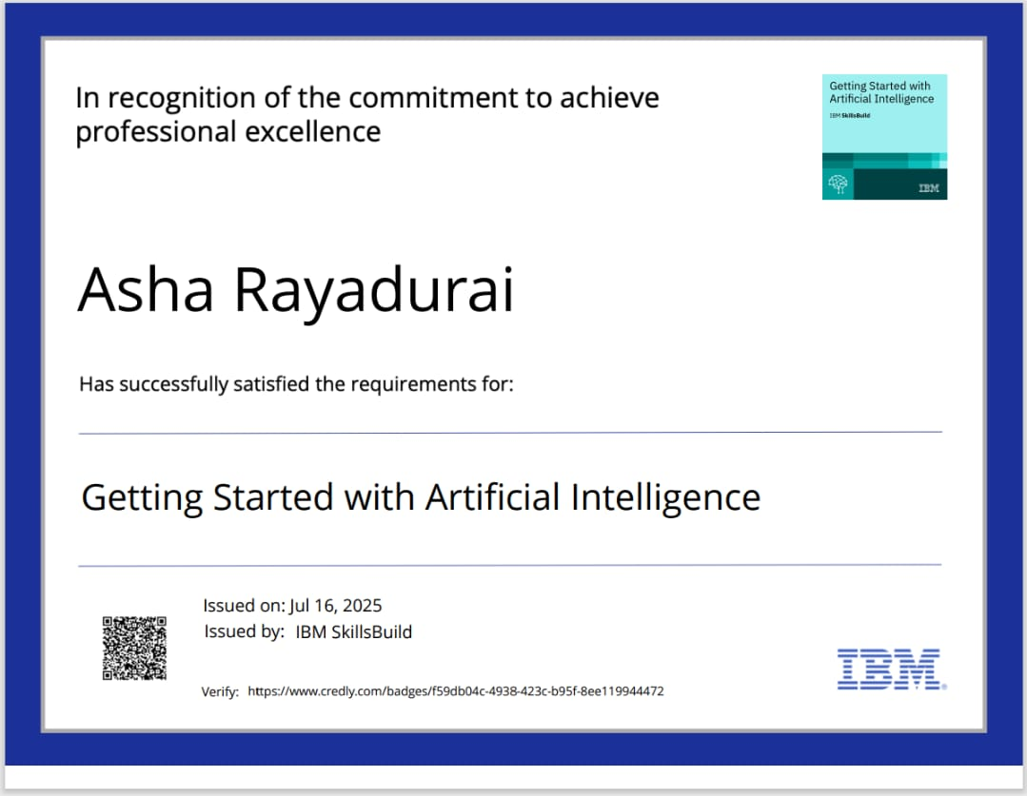
IBM Certifications

Slide 14
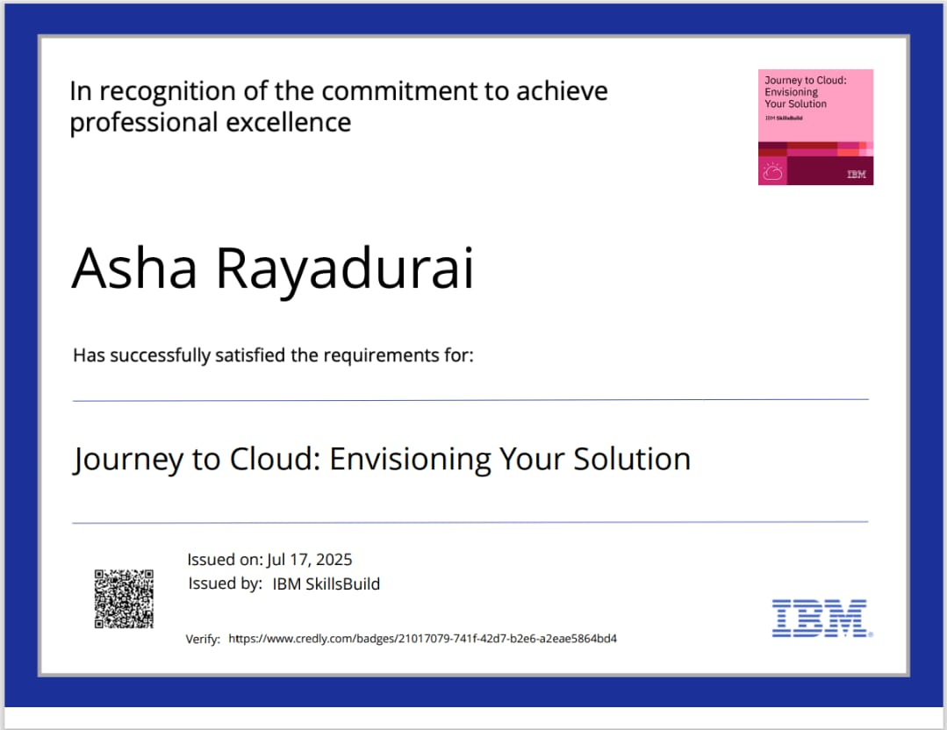
IBM Certifications

Slide 15
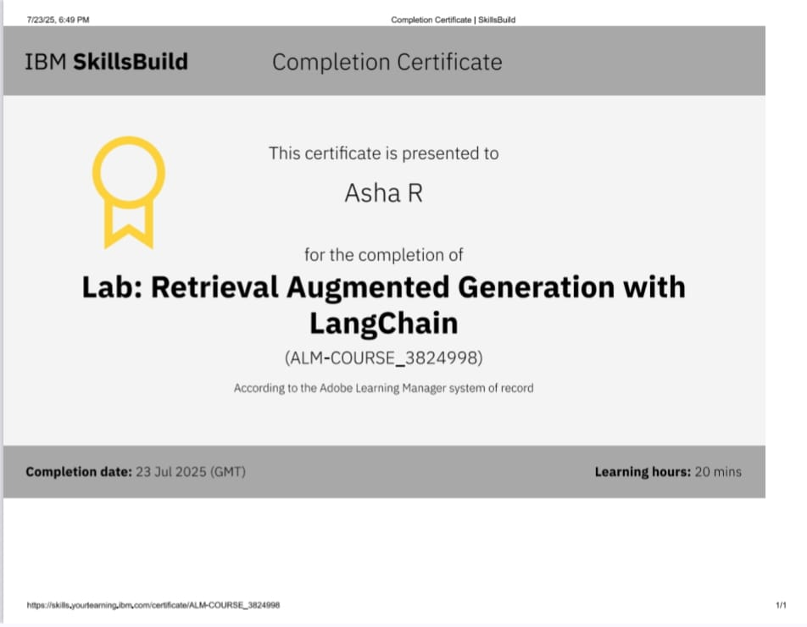
IBM Certifications

Slide 16
THANK YOU

